Slide 1

Medical Murder is the #1 Cause of Death in the U.S. – By Design (People Are Too Expensive – Satan’s Big Lie)
Who? They’re All In On It!

Slide 2

We’ve been programmed to believe lies – from all sides and angles

Slide 3
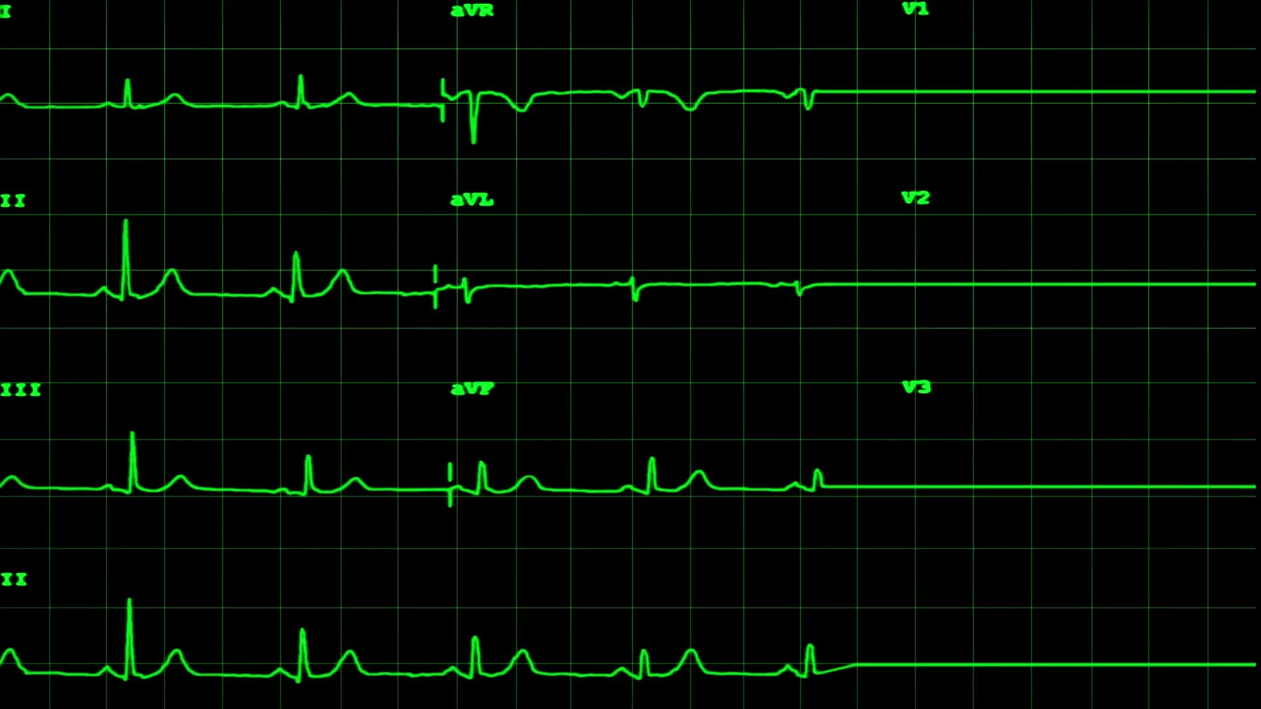
Facts:
Historical facts – pre-COVID
Annual deaths: 700K heart disease; 600K cancer; 400K medical “malpractice” (3rd leading cause of death)
https://www.statnews.com/2021/08/04/medical-errors-accidents-ongoing-preventable-health-threat/#:~:text=Injury%20or%20illness%20caused%20by,under%20wraps%20%E2%80%94%20and%20they%20are
Current facts – COVID Era and Post COVID
All cause mortality increase of 24% in vaccinated
https://www.israelnationalnews.com/news/317091
All cause mortality increase since January 2020 – weekly graph
https://ourworldindata.org/grapher/excess-mortality-p-scores-average-baseline?country=~USA

Slide 4


Medical Industrial Complex

Slide 5
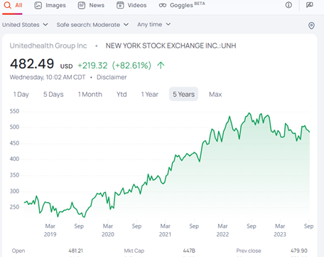
UnitedHealth Group
The world’s 11th largest company
Stock price $215 before Covid to $521 the day Covid is announced to be over
Value of $200B to 500B from Covid

Slide 6
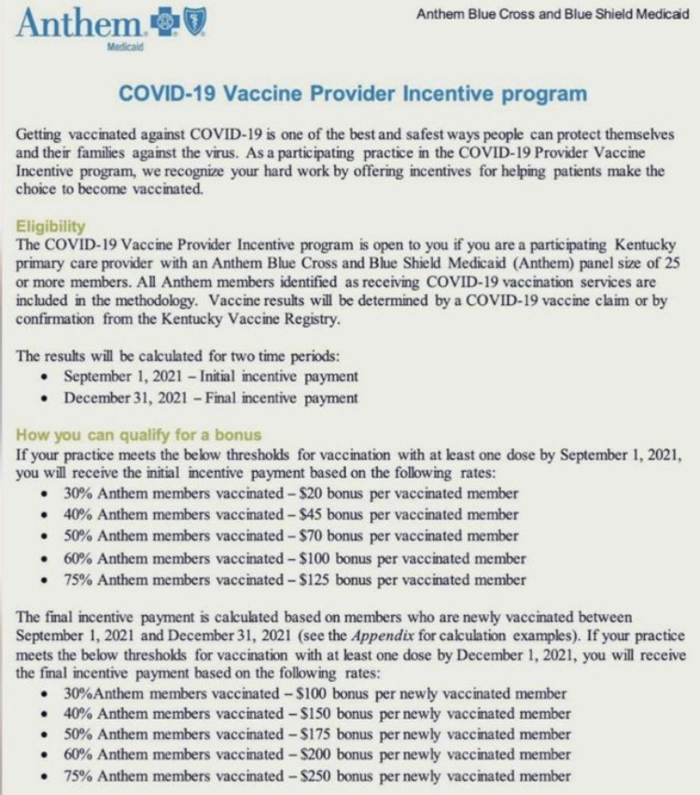
Follow the $$!
Average patients per doctor = 2,500*…
With 30% vaccinated by September 1 and 75% by December 1 = $296,250 doctor bonus from insurance company!
*https://www.elationhealth.com/resources/blogs/how-many-patients-are-most-primary-care-physicians-seeing

Slide 7
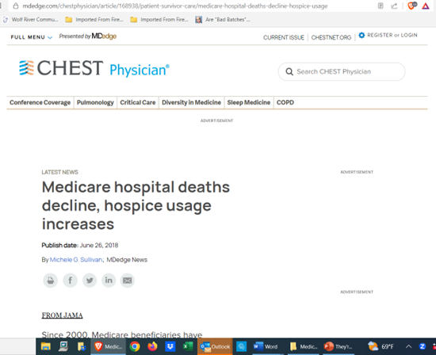
What about Hospice Care?
From 2011 to 2015: Dying in hospice care increased from 21.6% to 50.4%
https://www.mdedge.com/chestphysician/article/168938/patient-survivor-care/medicare-hospital-deaths-decline-hospice-usage
Why?
https://www.nbcnews.com/health/health-care/doctors-say-hca-hospitals-push-patients-hospice-care-rcna81599

Slide 8
Conclusion: Hospitals, doctors and nurses are incentivized, directly and indirectly, to hasten death. Hastening death = murder.

Slide 9

The Federal Government

Slide 10
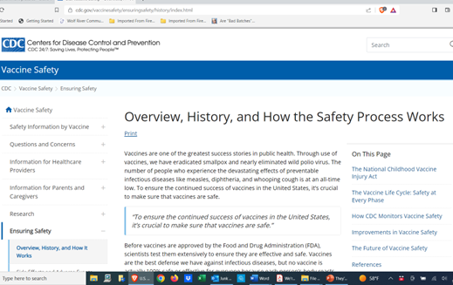
CDC promotes the vaccine narrative; hiding the truth Lie: https://www.cdc.gov/vaccinesafety/ensuringsafety/history/index.html Truth: https://childrenshealthdefense.org/vaccine-secrets/

Slide 11

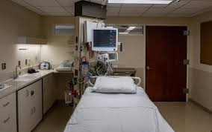
Numbers Don’t Lie
COVID Hospital Deaths
U.S. 1.2M
India 0.5 M
Population
U.S. 335M
India 1.4B
World 8.0B
Why? Hospital deaths drive fear and the “need” for a cure

Slide 12
Medicare/Medicaid costs set up the collectivism lie
The system’s diagnosis - “The financial projections in this report indicate a need for substantial changes to address Medicare’s financial challenges.” https://www.cms.gov/files/document/2021-medicare-trustees-report.pdf (page 11).
Think this through: Medicare/Medicaid is the ultimate bait and switch – we payroll deduct so we have “free health care” when we retire; remember, we paid for this ‘privilege’ our entire working life, but it is wrapped up in bow looking like our government is taking care of the elderly and the disabled. Then, they program us to bow down to the doctor and they license the doctor, so he won’t be paid unless he follows CMS Standards of Care designed to hasten our deaths.
CMS says 135M on program: https://www.cms.gov/newsroom/news-alert/cms-releases-latest-enrollment-figures-medicare-medicaid-and-childrens-health-insurance-program-chip
Over 50% of the annual federal budget is related to these bureaucracy!

Slide 13
Conclusion: Medicare and Medicaid were put in place much like the American Cancer Society – making it look like the government is taking care of the disabled and elderly https://live.childrenshealthdefense.org/chd-tv/shows/good-morning-chd/murder-by-protocol/

Slide 14


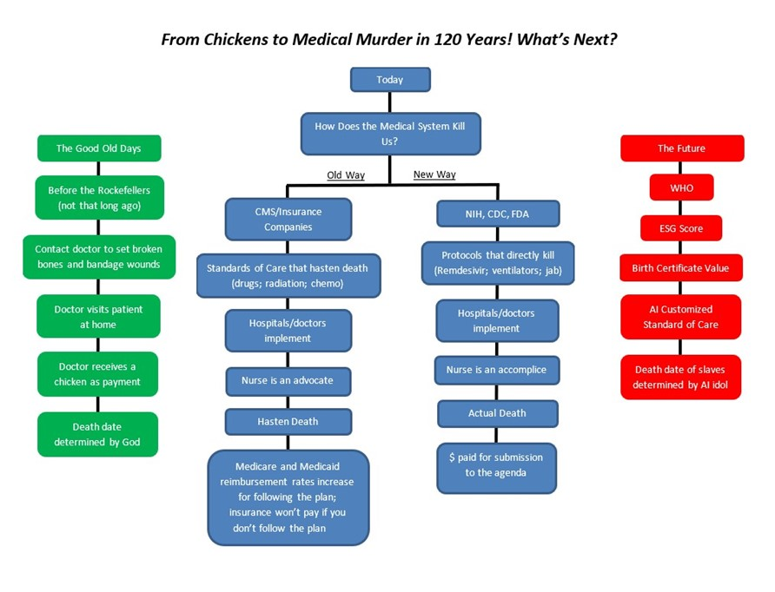
When the Federal Government and Medical Industrial Complex are in bed together, on Team Satan…

Slide 15

State Legislation – Now We Need a Court When Our Rights are Violated

Slide 16

Stella Liebeck story from 1992: 79 year old lady spilled hot coffee on her lap
Designed propaganda facilitated Republicans implementing next level tort reform
https://www.youtube.com/watch?v=pCkL9UlmCOE

Slide 17
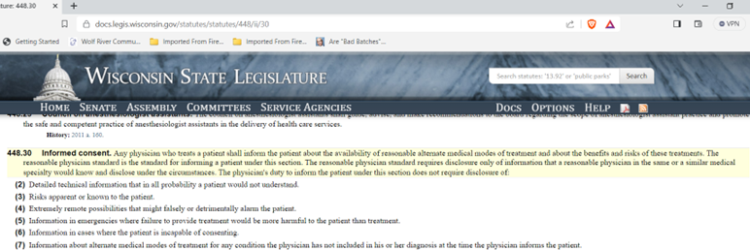
What does tort reform look like?
State legislators enact State Statute 448.30 - lack of Informed Consent is the cause of medical murder; note there are no consequences for not providing informed consent in the statute. The “enforcement” is by the Medical Examining Board, which is 13 members, 10 of which are physicians!

Slide 18
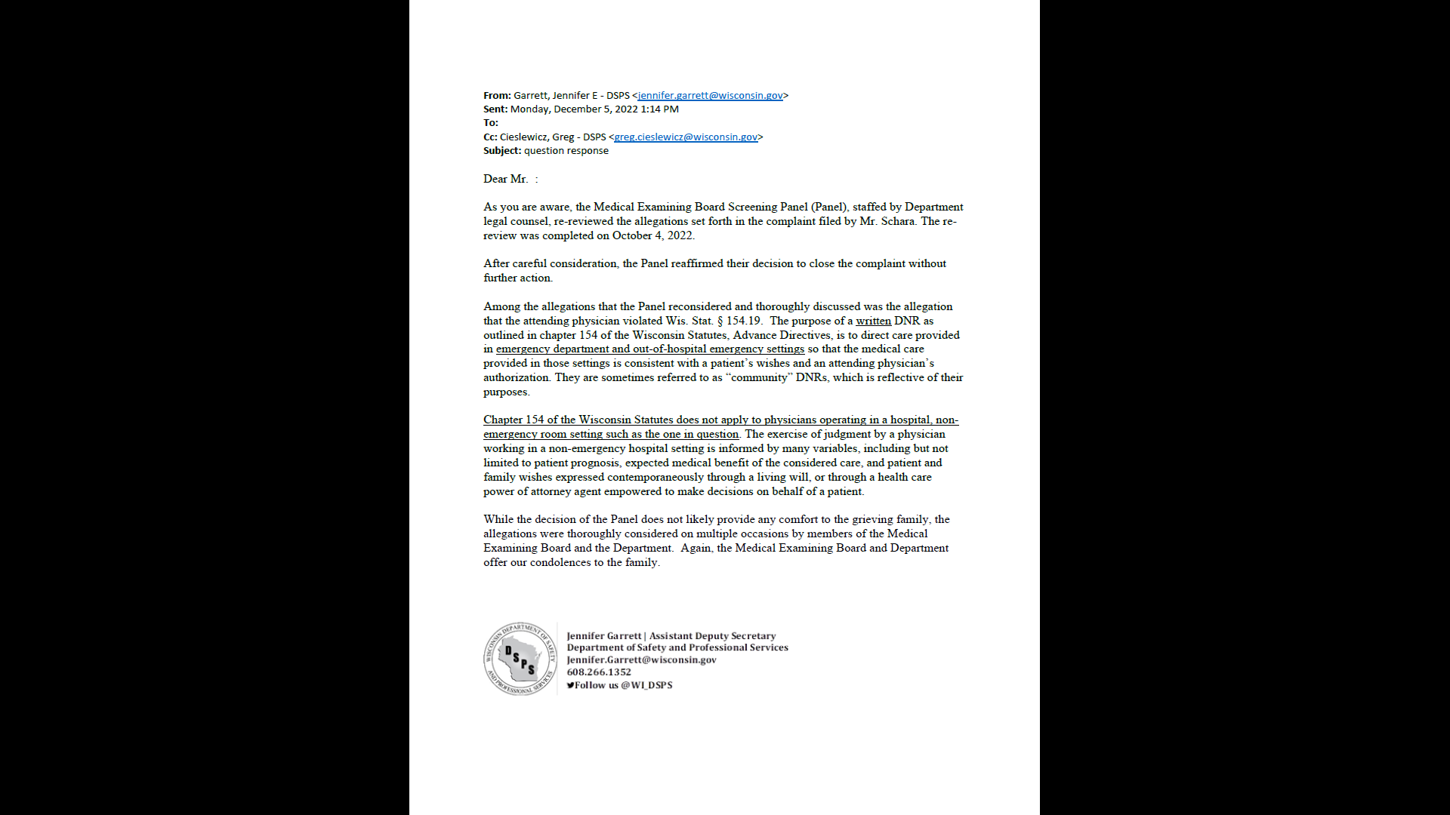

Slide 19
Conclusion: Legislation has become another satanic dialectic to trick us to thinking we can use man’s ways to fix things. We cannot contract morality. We have a God problem, not a legal problem. Article 1 section 12 of our State constitution says no ex post facto law can be passed. No statute can be made over the contract the legislators swore to abide by. So, the legislature cannot write a law allowing immunity for doctors from harming the people or taking the rights of the people out of their hands by writing procedures or immunities to protect the medical community from being held accountable.
This system cannot protect the American people and wasn’t designed to do so!

Slide 20

BIG Business

Slide 21


Slide 22

COVID exposed the agenda to have big corporations do the government’s bidding
Catherine Austin Fitts explains:
https://www.youtube.com/watch?v=iK5V89fU61Y&t=1593s&pp=2AG5DJACAQ%3D%3D

Slide 23
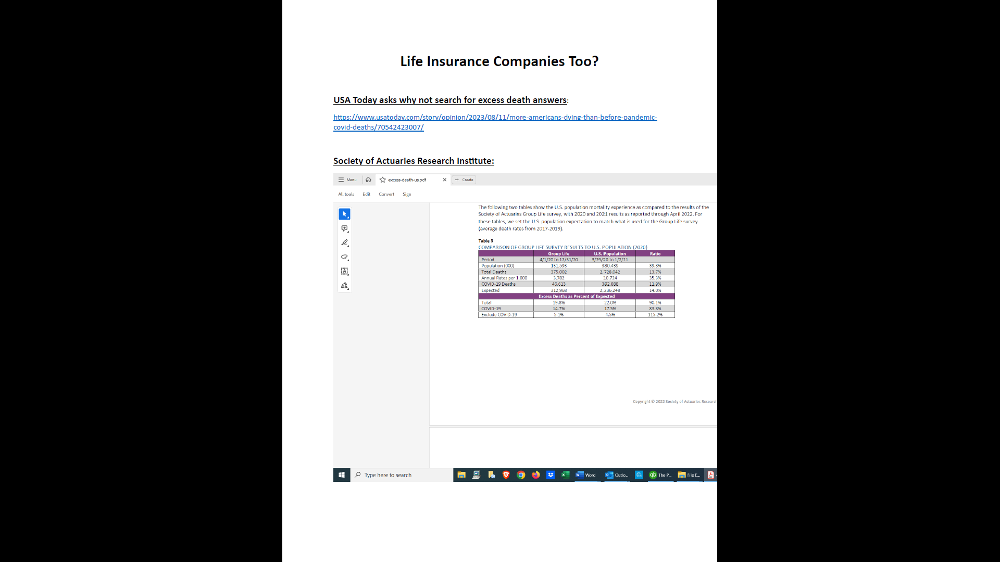

Slide 24


Slide 25
Conclusion: Our government can’t directly control us, because of our constitution, so uses big businesses. Would Target and Anheuser-Busch make such stupid marketing blunders if we really had a free market?

Slide 26

Churches

Slide 27
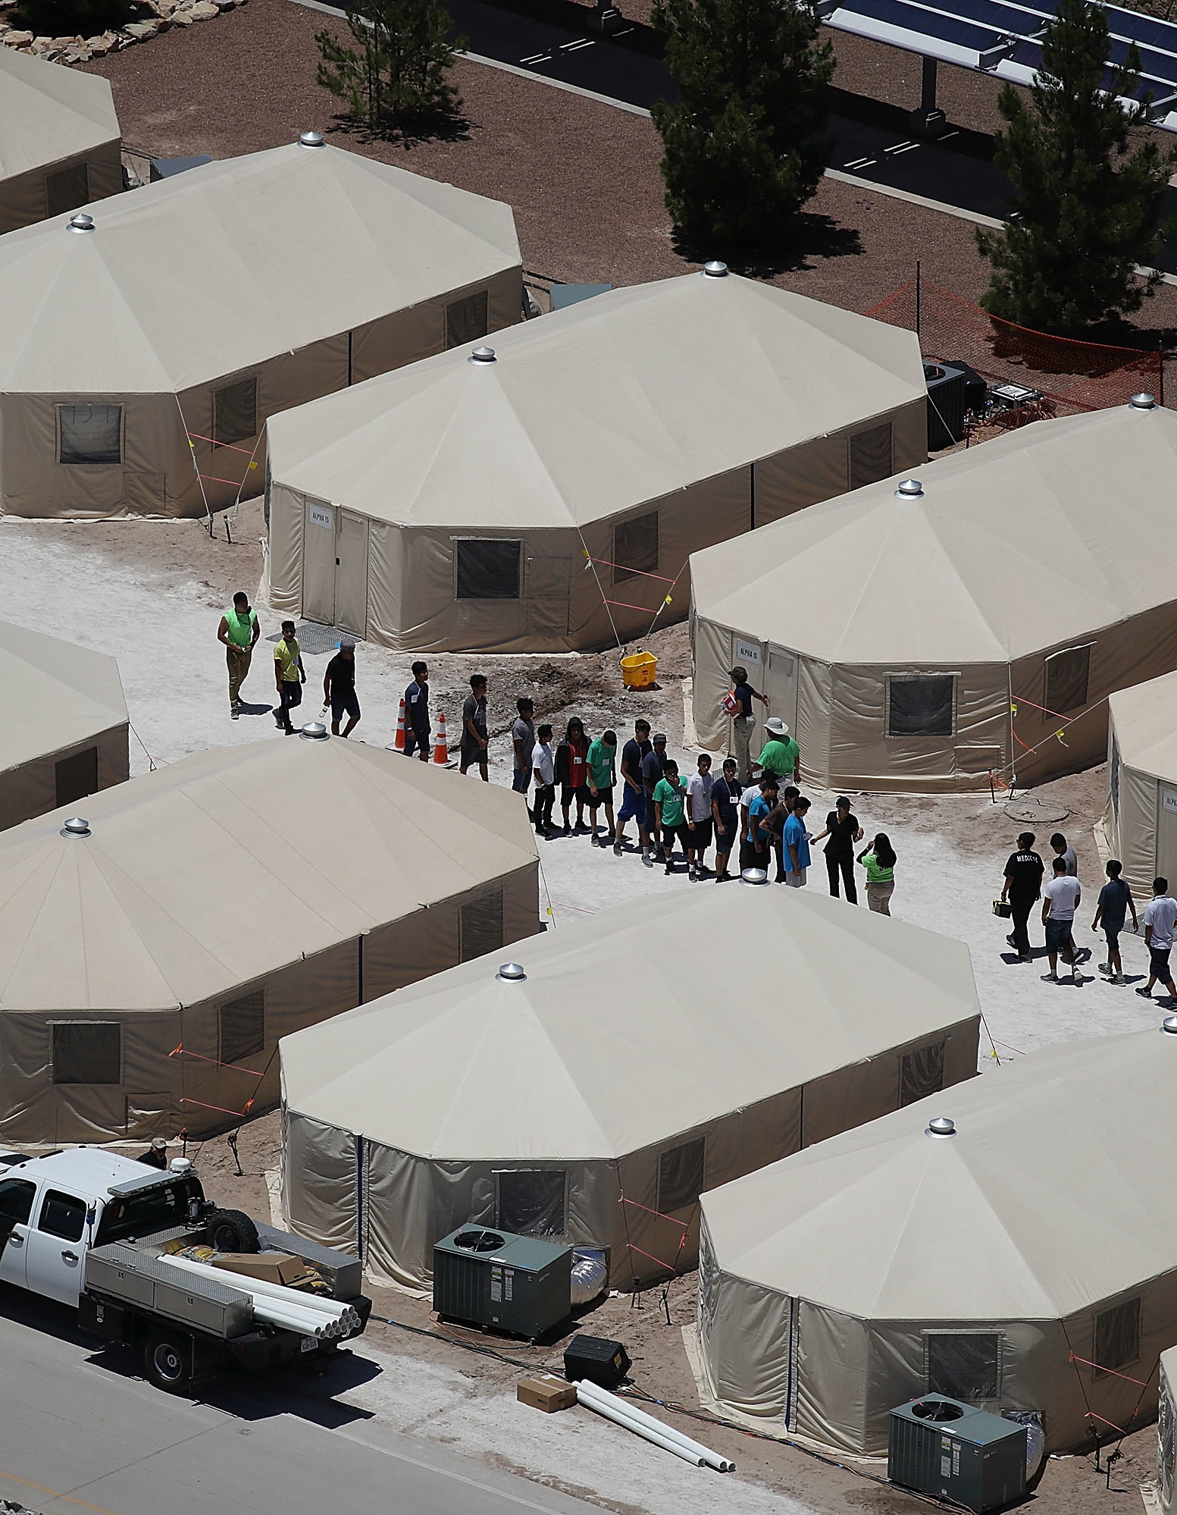
One reason: FEMA Training for Pastors
Began in 2006
“Pastors were asked to make a pledge or an affirmation during the meeting to fulfill the roles ascribed to them by FEMA. They were given assurances that they would be covered by full compensation in the event of resisters injuring them during property seizures and round-ups”
28,000-100,000 pastors were recruited by FEMA/DHS as part of Clergy Response Team
Similar to the role of churches under the Nazi regime
“These discussions, however, tended to become focused more on secondary strategic considerations – like maintaining good relations with colleagues in the German Churches – than on the central humanitarian issues that were really at stake”
“Sing a little louder” is a testimony shared by a German Jew who watched from his place of worship each week trains carrying Jews into a concentration camp
Diedrich Bonhoeffer – “Not to speak is to speak; not to act is to act.”

Slide 28
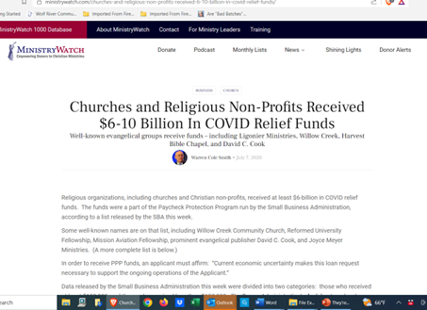
Churches closed doors and received COVID grants

Slide 29
Conclusion: Separation of church and state, along with Christian seminary funding by the Rockefellers has changed the landscape in recognizing and fighting spiritual warfare. When pastors water down the truth of Romans 13 and 14, the people don’t see the need for repentance and become sheep being led to slaughter.

Slide 30

Controlled Opposition?

Slide 31

Some Examples:
Doctor David Martin – big pharma can continue if they assume 100% product liability; they are already in bed with the only one who can play sheriff; we cannot legislate morality
https://forbiddenknowledgetv.net/dr-david-martin-to-eu-parliament-corona-virus-is-a-bioweapon-greatest-crime-against-humanity-in-world-history/
Attorney Tom Renz calling for congressional investigation. Congress passed the legislation to cause this. Think about what happened on 11/14/86 The National Childhood Vaccine Injury Act (NCVIA) of 1986
https://www.naturalnews.com/2023-05-23-renz-calls-investigation-hospital-murders-covid-pandemic.html

Slide 32
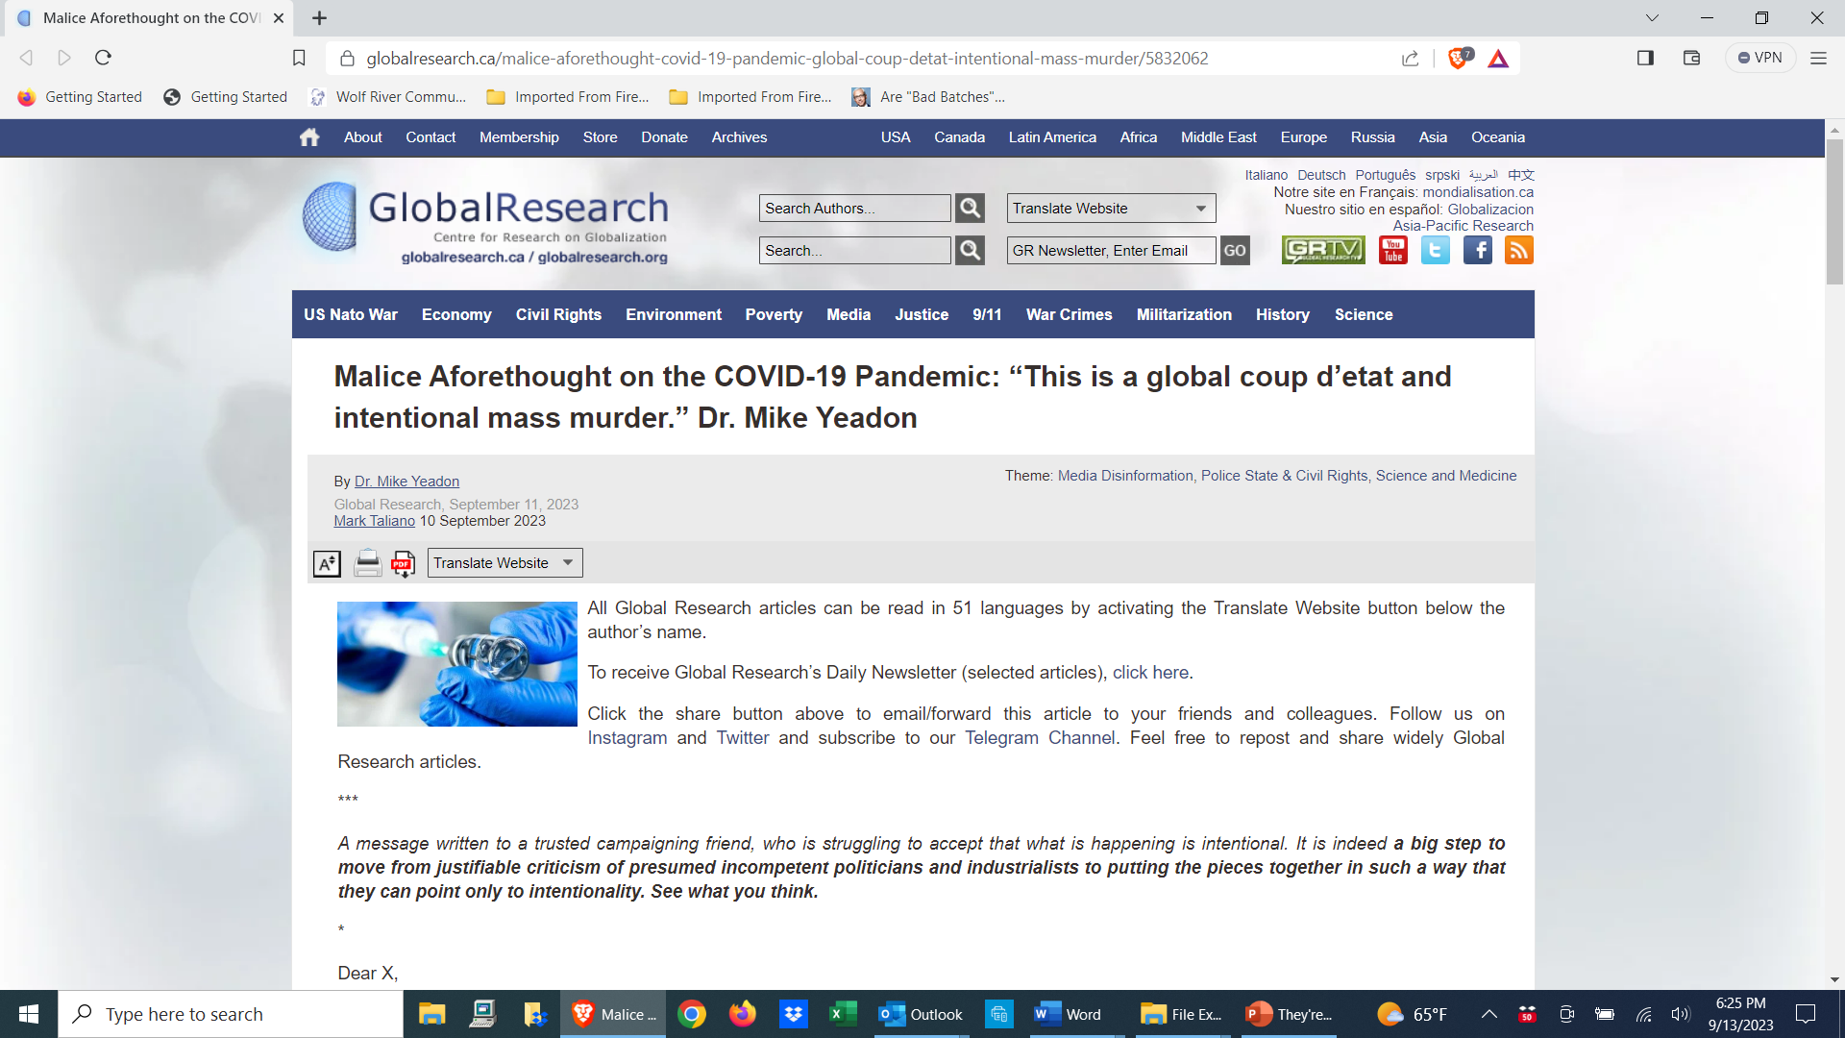

Slide 33
Conclusion: The apparent controlled opposition seems to be setting up an amnesty play, keeping us focused on the COVID PSYOP while even worse evil is being unrolled, without the same exposure.

Slide 34
Medical Murder is the #1 Cause of Death in the U.S. – By Design (People Are Too Expensive – Satan’s Big Lie) Up Next…
What? The Culture of Death

